Slide 16
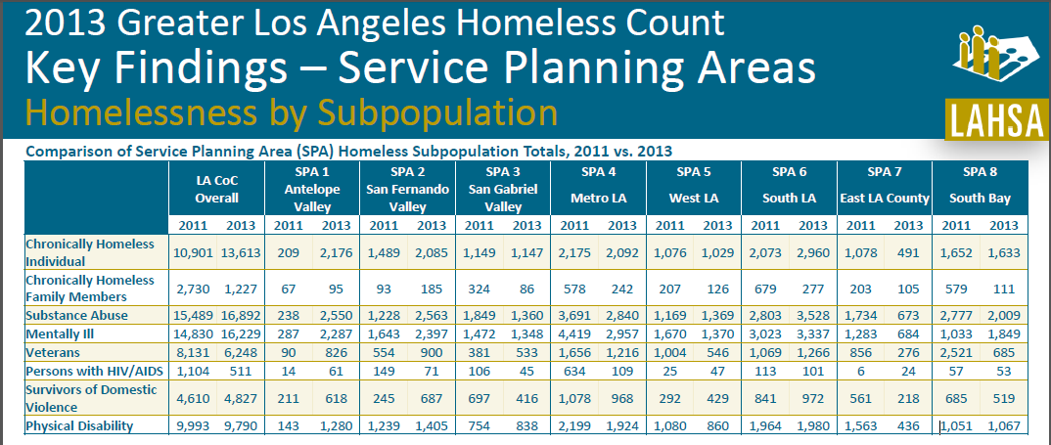

Slide 17
So far, in SPA 3 …
498
Assessed using VI-SPDAT
328
167
Highly Vulnerable
50
35
Chronically Homeless
Completed Match Form
Matched to Housing

Slide 20
SPA 3
Assess 700 Chronically Homeless Individuals using the VI-SPDAT (50% of PIT)
230 Chronically Homeless Individuals Assisted with Housing Navigation (housing document collection, accompaniment, etc. )
175 Chronically Homeless Individuals Housed Through CES (# 50 Veterans)
85% Housing Retention Rate
Dartboard Test – 100% SPA Coverage
*Outcomes are shared. A success for CES is a success for your program too.

Slide 21
•
•
•

Slide 23
Three Regions (West, Central, East)
Multiple Assessment Sites – One Regional “Hub” (Site of Bi-Weekly Navigator Meeting, and Central Storage of Consents)
100+ Identified Housing Resources
Designated Coordinators and Navigation Staff
Flex Funds to assist with: document collection, move-in, etc.
Monthly Training Opportunities
Leveraged Resources – In-Kind, Mental Health, Veterans Services, etc.

Slide 25
•
•
•
•
•

Slide 26
VI-SPDAT!
What is CES?
Do I need to sign a consent?
What’s a UCI?

Slide 27
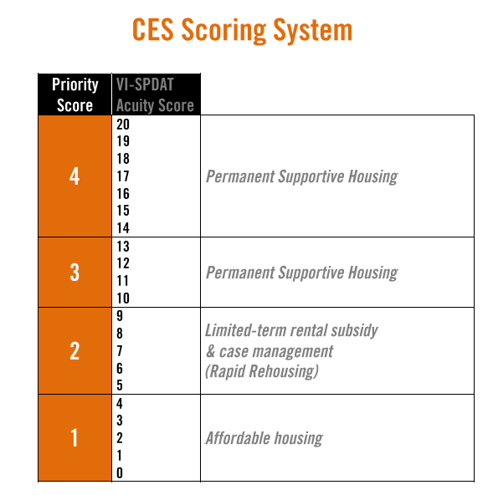

Slide 28
Case Conferencing
Navigator Meetings

Slide 30
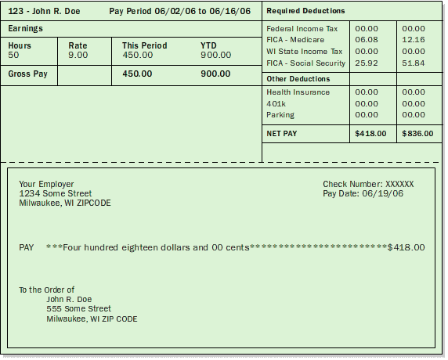
MIF
Match Initiation Form

Slide 32
Vacancy Request Form

Slide 33
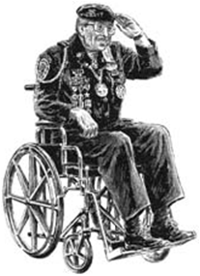
Housing Match

Slide 34
Bridge Housing

Slide 37
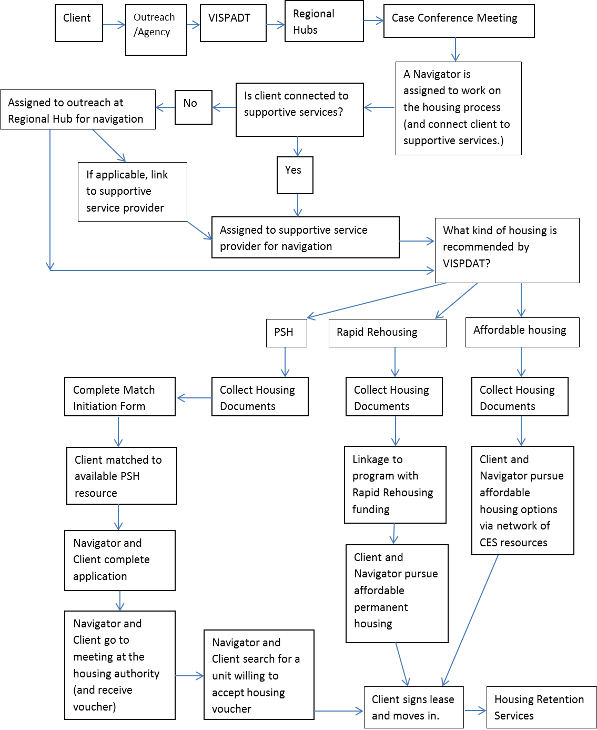

Slide 38
•
•
•
•
•
•
•
•
•

Slide 41
SPA Teams
Systems
Team
Policy
Team

Slide 42
Be Part of the Movement…
http://www.ted.com/talks/derek_sivers_how_to_start_a_movement

Slide 45
Start completing VI-SDATs with homeless individuals you’re working with.
Involve yourself on one of the planning teams – talk to your region’s coordinator.
Notify SPA Coordinator about housing resources that you’d like to see available through CES.
Educate your colleagues.
Plan to attend bi-weekly Navigator Meetings.
Determine the role your organization will play (Assessment site, referral site, navigation services, In-Kind resources, etc. )

Slide 46
RESOURCES:
CES Website - http://ceslosangeles.weebly.com/
CES Forms - http://ceslosangeles.weebly.com/forms.html
SPA 3 CES Consent - http://ceslosangeles.weebly.com/spa-3-pasadena.html
Current SPA 3 CES Leadership –
Ryan Izell – rizell@unionstationhs.org
Hillary Evans – hevans@ndvets.org
Lisa Cooper – Lcooper@voala.org
Reggie Clark – rclark@voala.org
Shawn Morrissey – smorrissey@housingworksca.org
Todd Palmquist – todd@sgvc.org

